Slide 1


Slide 2







Today’s Agenda
Agenda Tiles are clickable & jump to that section
BDS Logo upper right on each slide will bring you back to this Agenda

Slide 3


MENTORING & COACHING

Slide 4
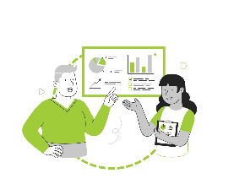






A DIFFERENCE MAKER
Retention rates are much higher for mentees (72%) & mentors (69%) than for employees who did not participate in mentoring
46% of employes voluntarily leaving a company cite the lack of opportunity to learn new skills as the number one culprit
91% of employees who have a mentor state they are satisfied with their jobs with more than half saying they are “very satisfied”
75% of millennials say mentoring is CRITICAL to their success
Mentoring programs boost promotion & retention rates for minorities and women by 15% to 38%
Employees who received mentoring were PROMOTED 5x more often than those who didn’t have a mentor
It pays to mentor, develop & promote from within. Beginning salaries for external hires are 18-20% more. Add advertising, along with time spent interviewing & time training - external hires can cost up to 50% more than internal hires
Notes:
Let’s take a look a some of the various ways research states that Mentor can make a difference.
Other stats
In fact - In a recent study from LinkedIn – 94% of employees stated they would stay in their current role longer if the company invested in their professional development
90% of people with a workplace mentor say it’s valuable.
89% of those who have been mentored will also go on to mentor others.
67% of businesses reported an increase in productivity due to mentoring
87% of mentors and mentees feel empowered by their mentoring relationships and have developed greater confidence (Moving Ahead research, Turning the gender diversity dial)
82% state that mentoring relationships help foster meaningful connections between mentors and mentees, across departments and the organization (Moving Ahead research, Turning the gender diversity dial)

Slide 5




THE RIPPLE EFFECT
67%
82%
State mentoring relationships helped foster MEANINGFUL CONNECTIONS between mentors & mentees, across departments & within their own team
91%
Developed or strengthen NEW SKILLS as a result of their manager being mentored
Of businesses reported an INCREASE IN PRODUCTIVTY due to mentoring
Harvard Business Review Analytic Services, sponsored by Torch
Notes:
67% of businesses reported an increase in productivity due to mentoring

Slide 6
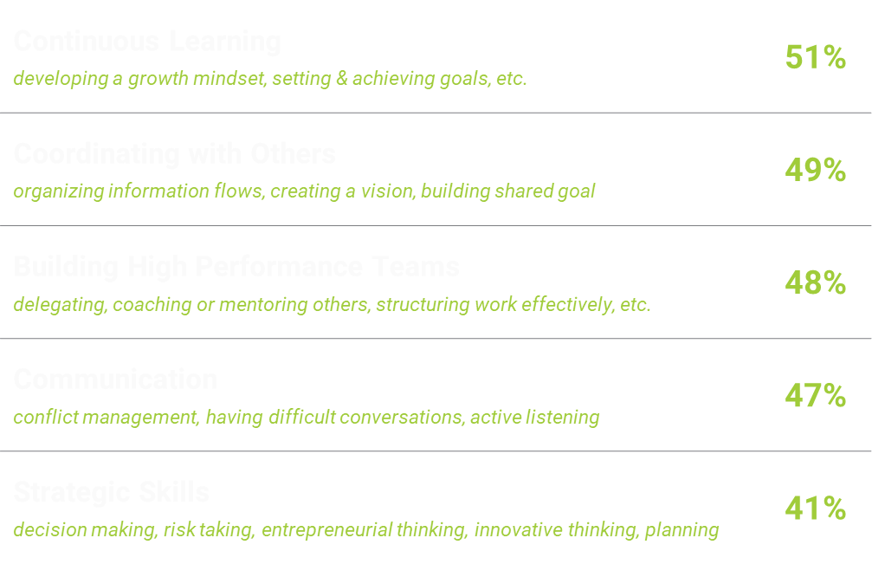
THE RIPPLE EFFECT
The Top 5 Skill CATEGORIES EMPLOYEES STRENGTHENED After Their Manager Experienced Mentoring & Coaching
91%
Developed or strengthen NEW SKILLS as a result of their manager being mentored
Harvard Business Review Analytic Services, sponsored by Torch
Notes:
When managers change, their teams change. Employees whose manager received mentoring reported changes in their own skills as a result

Slide 7
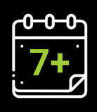
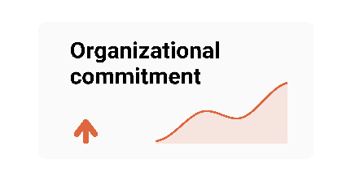
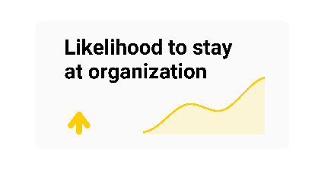
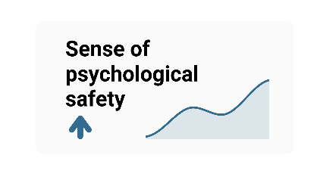
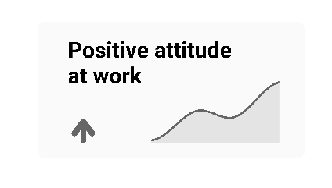
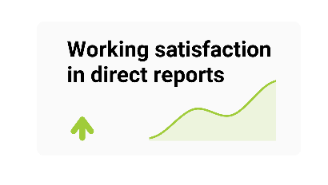
DURATION IMPACT
The longer a manager is mentored & coached, the stronger the impact
Months
of mentoring & coaching is ideal according to participants
A LONGER DURATION of mentoring & coaching leads to...

Slide 8
The purpose of the BDS Mentor Program is to facilitate a structured and supportive environment dedicated to professional and personal development. Through a carefully matched mentee/mentor selection process, our objective is to offer enriching experiences for career and personal growth, enhance business acumen and leadership capabilities, foster cross-departmental knowledge sharing, contribute to organizational succession planning, and above all, empower BDS Mentees to navigate challenges, seize opportunities, and realize their full potential.
Notes:
The primary purpose of the mentoring program is to partner with our employees on their personal and professional development – as mentors we can help facilitate enriching experiences for their career and personal growth, help them explore and enhance their leadership capabilities, foster cross-departmental knowledge sharing and above, empower them to fully realize their potential;.

Slide 9

PROCESS & TIMELINE

Slide 10
TIMELINE
Jan
Feb
March
May
Aug
Nov
Mentor Kick-Off Meetings (3 options to choose from)
Finalize Mentees candidate list & send invitations to participate
Host Mentee Kick-Off Meetings (3 options to choose from)
Provide kick-off meeting attendees access to the interactive “Mentor Bio Media” Files
Mentees complete “Mentee Participant Application” & request mentors (1st, 2nd, 3rd choice)
Mentees request 3-month, 6-month or 9-month mentoring experience
TD & HRBPs Match mentees with mentors - gain acceptance from mentor
Send out match notification emails with next step instructions
Give Mentors & Mentees access to “Mentor Program Resources” on the Hub
Initial Mentor/Mentee Meetings take place
Mentees & Mentors complete the initial meeting checklist
TD & HRPBs conduct 3-month check-ins
Wrap-up of 3-month mentorships
TD & HRPBs conduct 6-month check-ins
Wrap-up of 6-month mentorships
Last Mentor/Mentee meetings take place
Host Lunch & Learn Recaps
Host Program celebration with certificates of completion
Complete post program evaluations

Slide 11

SELECTION & MATCHING

Slide 12
BECOMING A MENTOR
MENTORS may request to be involved or may be recommended by others
Criteria for Involvement:
  Employed with BDS for at least 12 months -- exceptions made with senior level approval
  Endorsed by Direct Manager or a BDS VP
  Positive role model of BDS values of Authenticity, Achievement & Agility
  Familiar with & adheres to all company policies & employment requirements
  Committed to program time requirements
    2024 year
    3-month , 6-month , or 9-month timeframe as requested by Mentee
    Minimum of 2-3 hours per month
  Provides needed information to create online interactive “Bio Media File”
  Understands & strives to meet defined “Mentor Role Expectations”

Slide 13

MENTOR | ROLE | ACCOUNT/DEPARTMENT
Tracy Neff | Executive Vice President, Client Service | Break Fix
Cory Hedin | Executive Vice President, Client Service | Client Service
Jack Murphy | Executive Vice President, Client Service | MAG
Hanoz Gandhi | Sr. Vice President, Technology & Analytics | Technology & Analytics
Cari Desiderio | Sr. Vice President, Human Resources | Human Resources
Joe Cundari | Sr. Vice President, Finance | Finance
Jennifer Fisher-Finnegan | Sr. Vice President, Sales & Marketing | Sales & Business Dev
Tara Hankins | Vice President, Client Service | AMD, Flex Force, Luxottica, Midea, Moto
Christina Ibach | Vice President, Client Service | Meta, iRobot, Qualcomm
Stan Sliva | Vice President, Client Development | Business Development
Lauren Judkins | Vice President, Client Service | Break Fix
Jeremy Rodgers | Vice President, Operations | Internal Operations
Melissa Burke | Associate Vice President, Marketing | Marketing
Lisa Nichols | Associate Vice President, Client Service | Break Fix
George Plumb | Sr. Director, Marketing Strategy | Marketing
Mollie Gray | Sr. Director, Client Service | Microsoft
Manny Gouveia | Director, Client Service | Microsoft
John Fontana | Sr. Director, Client Service | Meta
Kia Reed | Director, Human Resources | Human Resources
Laura Miller | Director, Talent Acquisition | Recruiting
Lisa Ryerson | Director, Marketing | Marketing
Alexandra Nelson | Director, Strategy & Analytics | Analytics
Mike Gonzalez | Director, Client Service | Break Fix
John Barnett | Director, Client Service | Break Fix
Mary Meeks | Director, Field Operations | Break Fix
Dan Kress | Director, Field Operations | Break Fix
Jason Jones | Director, Client Service | Midea
Rita Sams | Director, Retail Operations | Retail Operations
Heidi Wahrhaftig | National Operations Manager | Flex Force
John Mullins | Sr. Business Analyst | Information Technology
James Dyer | Sr. Manager, Data Service | Information Technology
Kris Mora | Sr. Manager, Analytics & Strategy | Information Technology
Shelbie Smith | Sr. Manager, Client Service | Break Fix
Kricket Morton | Sr. Manager, Client Service | Break Fix
Haylee Brown | Sr. Results Manager | Break Fix
THANK YOU
35
35

Slide 14
BECOMING A MENTEE
MENTEES may request to be involved or may be recommended by others
Criteria for Involvement:
  Employed with BDS for at least 18 months -- exceptions made with Director or above approval
  Salaried or hourly full-time employment status -- rare part-time exception made with Sr. Executive approval
  Endorsed by Direct Manager, Director or VP -- includes Direct Manager approval for program time commitment
  Familiar with & adheres to all company policies & employment requirements
  Positive role model of BDS values of Authenticity, Achievement & Agility
  Committed to program time requirements
    2024 year
    3-month / 6-month / 9-month timeframe as requested by Mentee
    Minimum of 2-3 hours per month
  Understands & strives to meet defined “Mentee Role Expectations”
You can be a both a mentor & a mentee

Slide 15
THE 2-3 HOUR MONTHLY EXPECTATION
What can the minimum of 2-3 hours per month look like?
2-3 Hour Per Month Criteria
  A minimum 1 hour of face-to-face interaction via teams or in person -- may be broken up in to 30 min segments
  Ideally includes targeted Experiential Activities
    What meetings or shadow experiences are on your schedule that they could be included in? → Tip: calendar 15 min end of each week to review your upcoming calendar for opportunities such as an RFP planning presentation, client QBR, team meeting, etc.
    What projects or initiatives are in play that they would be interested in sitting in on or contributing to? (for example, HR/TD are working on content for a manager playbook on the HUB , TD is working on building some leadership development courses, or analytics may be doing some research)
    What company visibility networking or connections can you facilitate?
  May include time spent on recommended development resources (articles, TED Talks, podcasts, books, websites, LinkedIn courses, self-assessments, etc.)
  May include personal application challenges & stretch assignments (try this, see if you can put this into action, etc.)

Slide 16
SELECTION & MATCHING PROCESS
Mentee Selection & Pairing
  Mentee candidate list created from approved requests & recommendations
  Mentee candidates are invited to attend a “Mentee Kick-Off Meeting” to learn more about the program
  After attending the mentee kick-off meeting, Mentees who agree to participate must:
    Review & commit to “Mentee Role Expectations” & “Interactive Mentor Media Files”
    Submit “Mentee Participant Application” by designated date -- includes 1st 2nd & 3rd mentor choices*
  Following designated date, HR & Talent Development review form submissions & recommend Mentor Matches**
  Selected Mentors are notified of the mentor request/match & asked if they accept***
  If accepted – pairing introduction & instructions email sent
  * Ideally – one level above current role, possibly two
  ** Mentee/Mentor matches will be prioritized based on tenure, retention concerns, succession/business needs, performance level & quality of participation application using a priority matrix tool.
  ***A Mentor might have more than 1 mentee based on mentee timeframe requests ( i.e., 1 mentee for 3 months, 1 mentee for 6 months )

Slide 17
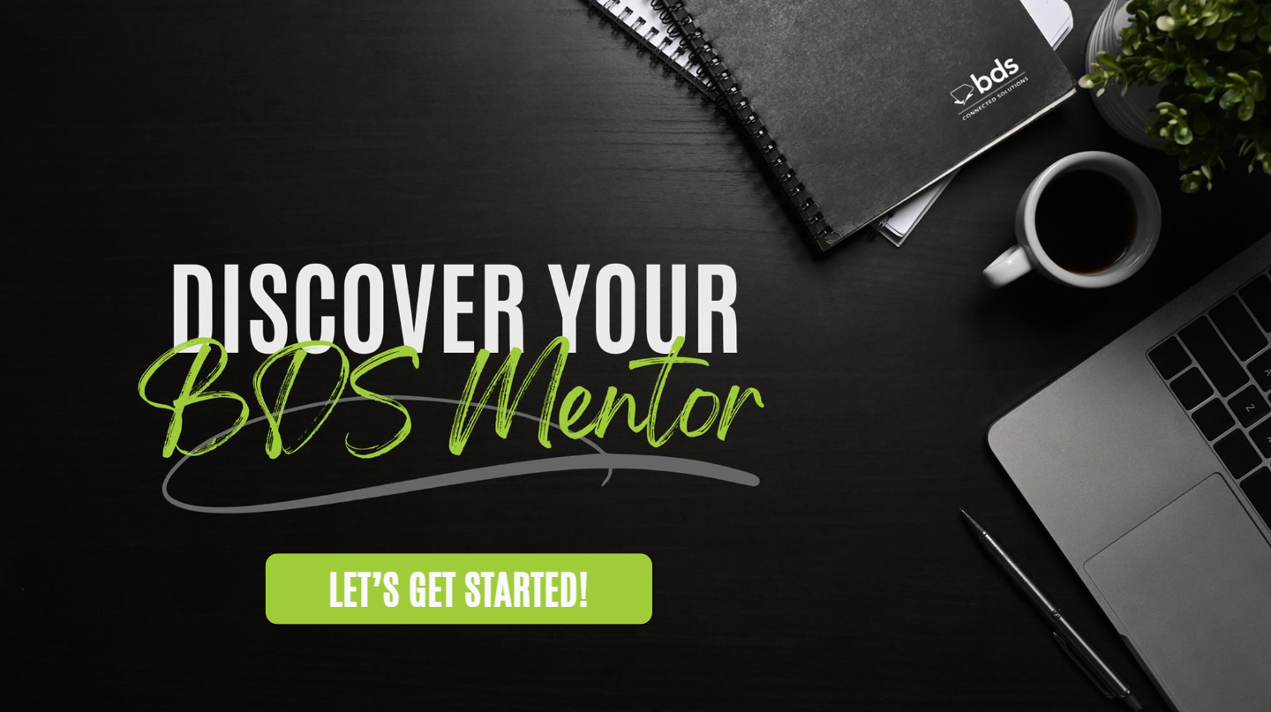

Slide 18
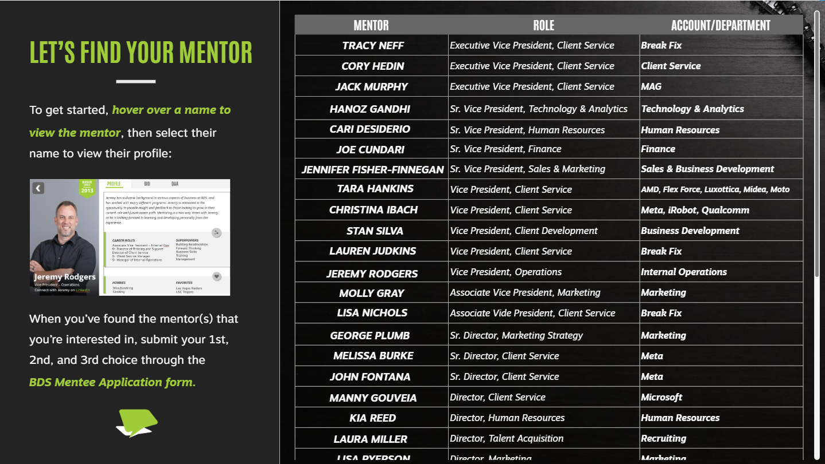

Slide 19
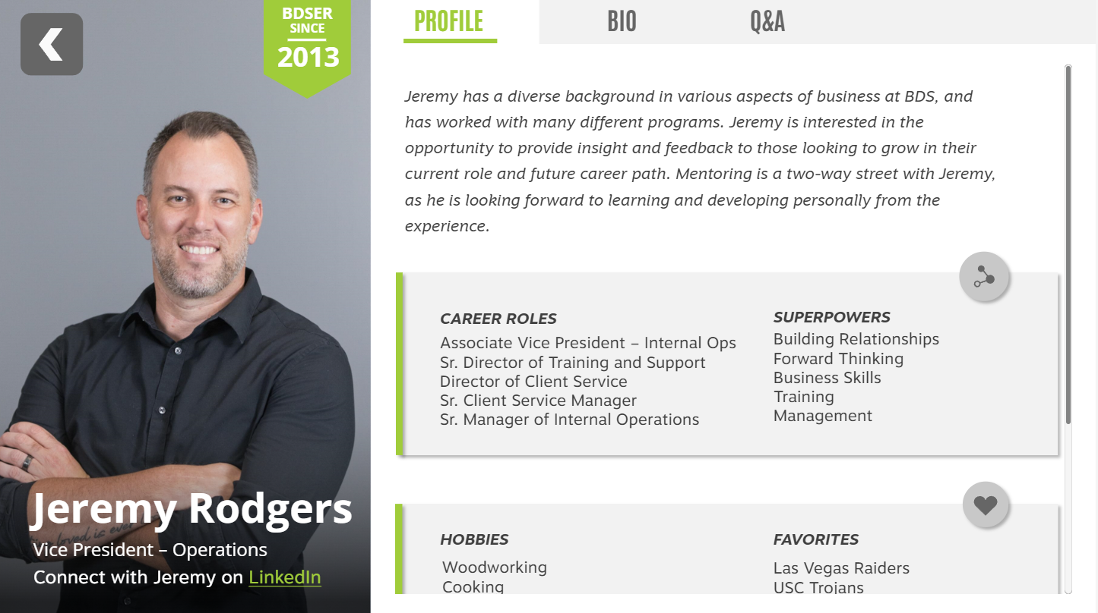

Slide 20
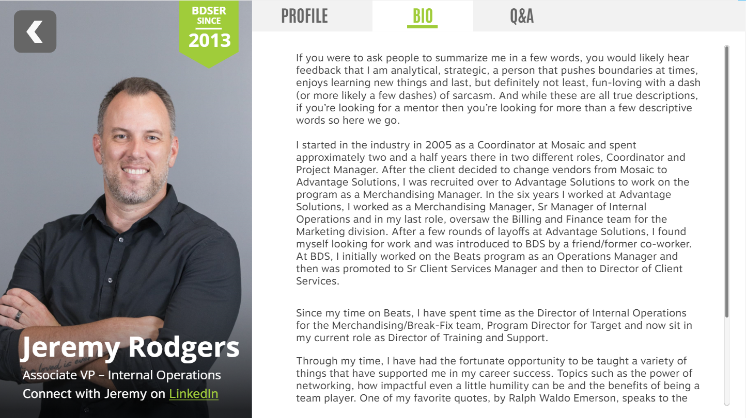

Slide 21
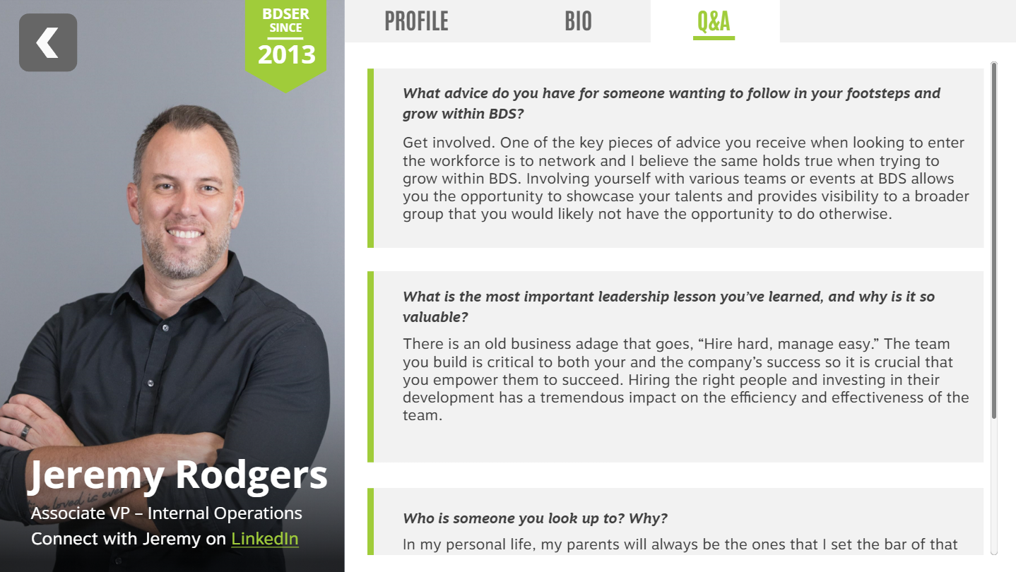

Slide 22
MENTEE PARTICIPANT APPLICATION
Application Questions Include:
  Preferred timeframe -- 3-month, 6-month, 9-month
  Preferred mentors -- 1st, 2nd 3rd choice & what they hope to gain from each mentor
  What they hope to gain from the program
  Personal development goals
  Career development goals
  Interest level in listed Topic-Based Workshops* -- Extremely Interested / Interested / Somewhat Interested / Not for now
  Opportunity to suggest workshop topics
  Questions/Comments
  * Topic Based Workshop Ideas: Leading Virtual Teams; Leading Thru Change; Project Management for Leaders; Successful Interviewing Skills; Managing P&L; Excel For Managers; Emotional Intelligence in Leadership; Managing Client Expectations; Coaching Skills for Leaders & Managers; Managing Team Conflict; Leading High Performing Teams; Future Focused Feedback; Impactful 1-1 Meetings

Slide 23

ROLES & EXPECTATIONS

Slide 24
MENTOR ROLE & EXPECTATIONS
THE NITTY GRITTY
Review your Mentee’s LinkedIn profile & follow on LinkedIn
Read thru your Mentee’s “Participant Application” entries & prepare questions to ask
Initiate & encourage informal chats via TEAMS throughout the mentoring experience (send first chat as soon as possible)
Meet at least 2-3 times monthly for 60 to 90 minutes
Be on camera for mentoring meetings when possible
Your Mentee is responsible for calendaring meetings, suggest dates/times that will work for you
Make mentor meetings a priority - if you need to cancel, find the time to reschedule (ideally within same week)
Review the “Initial Meeting Guide & Checklist” in preparation for your first meeting
Leverage the “Mentor Resources” shared on The HUB
THE BIG STUFF
Invest time early to really connect
Create a safe place for sharing & conversation
Discover more with questions
Lean into your superpower -- firsthand experiences & stories
Facilitate Connections -- connect & introduce your mentee to others
Tap into experiences -- identify experiential activities for your mentee – tip: look at your own calendar for ideas
Recommend development resources -- articles, TED Talks, podcasts, books, websites, etc.
Look for opportunities to facilitate self-reflection, discuss key take aways, apply key learnings, recommend stretch assignments
Highlight personal growth & celebrate wins
Notes:
Leverage the power of stories from your firsthand experiences

Slide 25
MENTEE ROLE & EXPECTATIONS
THE NITTY GRITTY
Review your Mentor’s LinkedIn profile & follow on LinkedIn
Read your Mentor’s online ”Media Bio” in full & prepare questions to ask
Complete the “Mentee Bio Slides” to share with your mentor @ your first meeting
You own & drive the scheduling - get the first meeting calendared quickly (don’t wait)
Leverage the “First Meeting Guidelines & Checklist” in preparation for your initial meeting
Meet at least 2-3 times monthly for 60 to 90 minutes
Be on camera for your meetings whenever possible
Make mentor meetings a priority – if you or your mentor need to cancel, find the time to reschedule (ideally within same week)
Connect & check-in informally via TEAMS throughout the mentoring experience
THE BIG STUFF
YOU OWN YOUR EXPERIENCE!!!
Invest time early to really connect
Prepare extensively for each meeting (know what you want to ask, topics you want discuss)
Ideally, prepare & share an agenda for each meeting (give your mentor time to reflect & prepare)
Follow up meetings with an email summary (what was discussed, key learnings, action items, etc.)
Retain emails to help with end of program recap
Keep a personal learning journal (best practices)
Be candid with your Mentor regarding what you are looking for
Stretch & challenge yourself, see things differently
Follow through on agreed activities, experiences, reflections
Leverage the “Mentee Resources” shared on The HUB
Respond to mentor program check-ins from Talent Dev
Attend end of program celebration & share key learnings
Notes:
Leverage the power of stories from your firsthand experiences

Slide 26

PROGRAM RESOURCES

Slide 27
A SNEAK PEEK!
Your Resources on The HUB
Mentor Resources | Mentee Resources | Shared Resources
10 Guiding Principles for Mentors What Millennials Want in a Mentor Things Great Mentors Do Differently The Different Roles You Play as a Mentor Questions Every Mentor Should Ask First Time Mentor? 4 Ways to Make an Impact Targeting Experiential Learning Opportunities Coaching Models to Choose From TOOLS & TEMPLATES Conversation Dialogue Prompts by Topic Mentoring Activities to do with Your Mentee Experiential Development Pick-list | What Mentors Wish Their Mentees Knew Mentee Best Practices Why Create a Mentoring Meeting Agenda Great Questions to Ask Your Mentor Connecting Authentically with Your Mentor Benefits of Being a Mentee The Value of Learning Journals 4 Types of Career Progressions TOOLS & TEMPLATES Mentee Bio Slides Template Questions to Ask Your Mentor Meeting Summary Email Template Personal Learning Log Journal What Should I Do if… | Mentor Meeting Recommended Agendas The 1st Meeting 2nd & 3rd Meetings Ongoing Meetings Wrap-Up Meeting Meeting Agenda Template Self-Reflection Activities & Worksheets Free Self-Assessments
ORGANIC & DYNAMIC RESOURCE LIBRARY

Slide 28

QUESTIONS OR SUGGESTIONS
What About or How About

Slide 29



OUR ASKS
So We Can KICK-OFF THIS PROGRAM . . .
Send Us Your Bio Forms
Recommend Mentees
Suggest Workshop Topics
Notes:
The purpose of the Mentorship Program is to facilitate a structured and supportive environment dedicated to professional and personal development. Through a carefully matched mentee/mentor selection process, our objective is to offer enriching experiences for career and personal growth, enhance business acumen and leadership capabilities, foster cross-departmental knowledge sharing, contribute to organizational succession planning, and above all, empower mentees to navigate challenges, seize opportunities, and realize their full potential.

Slide 30



